Slide 1
Capstone Project
Play Store App Review Analysis
Individual Project:
Advait B. kajarekar

Slide 2
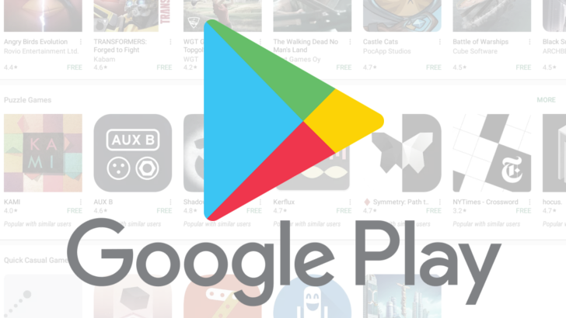
Introduction
The Play Store apps data has enormous potential to drive app-making businesses to success. Actionable insights can be drawn for developers to work on and capture the Android market. Play Store is one of the largest and most popular android app stores with over a million apps.
Our main objective is to analyze the dataset and find out which features contribute to app success and how these features affect the user engagement with the app.
The Project’s result may show the importance of reviews to apps in the market as it could be one of the determining factors for the number of installs

Slide 3
Steps Involved
Importing Libraries and data:- First, we imported all the python libraries required for this, which include NumPy, Pandas, Matplotlib and Seaborn. We read the CSV into a dataframe and pandas dataframe did the work for us.
Discover and understand data:- In this step, we observed the data by exploring few rows, checking shape, columns, data types etc.
Data Preparation:- Here we carried out data cleaning and data transform to make data efficient for analysis and visualisation.
Data Visualisation:- Visualized data with the help of graphs and plots to learn trends, patterns and get answers to the questions related to the data. This process helped us figuring out various aspects and relationships among features of the app.

Slide 4

Data Overview
Features:-
10841 Apps
App - name of the app
Category - category of the app
Rating - app's rating by the users out of 5
Reviews - number of the app's reviews
Size - size of the app
Installs - number of installs of the app
Type - whether the app is free or paid
Price - price of the app in $
Content Rating - target audience of the app
Genres - genre of the app
Last Updated - date the app updated last time
Current Ver - current version of the app
Android Ver - android version required to run the app
13 Columns
Different Data types
String
Integer
Float
Object

Slide 5
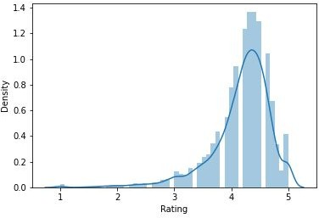
Data Preparation
Missing Data
Distribution of Rating
Overall 1476 null values
Rating has 99% of total missing values
Treating missing data
Analyzed features one at a time
Replaced rating missing values with median value
Treated other columns missing data in best way possible

Slide 6
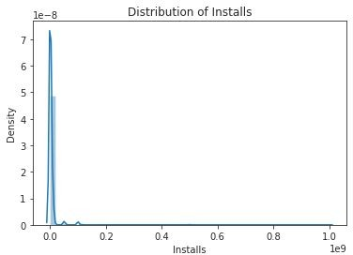
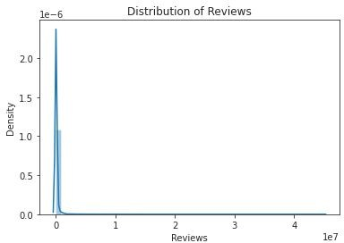
Data Preparation contd.
Data Transformation
Changed the data types to their original one
Performed Log Transformation on Installs and Reviews column

Slide 7
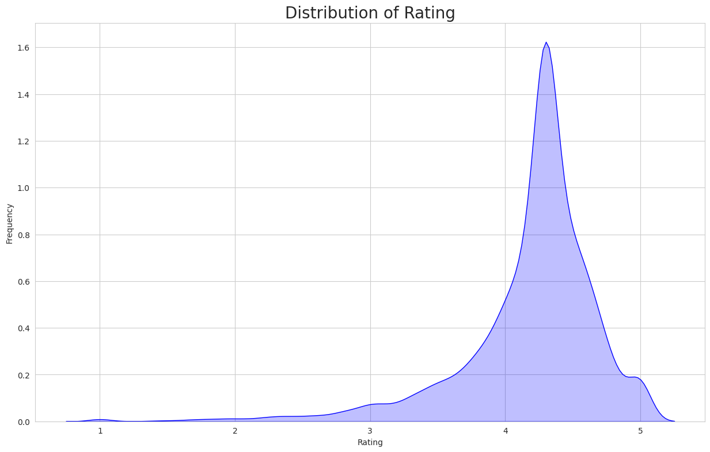
Data Insights
Distribution of Rating
Distribution of rating is negatively skewed
Most of the apps lie between 4.0 to 4.7 ratings.
Average rating is around 4.18
Most of the rating is above 3.5
Rating can be a variable to identify app success.

Slide 8
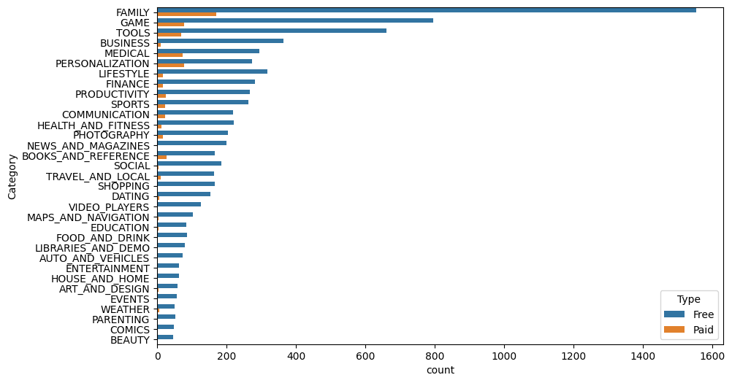
How many apps are there in each category?
Play store has 33 Categories in total.
Family category has most 1500+ apps.
The lowest number of apps are under Beauty & Comics Category.
Most of the paid apps are from Family , Games , Tools .Personalization and Medical category.

Slide 9
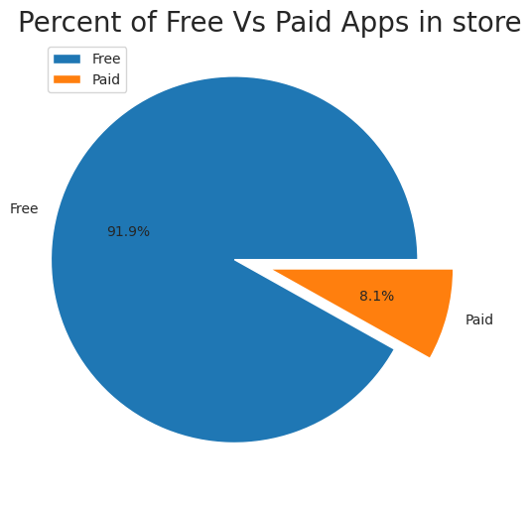
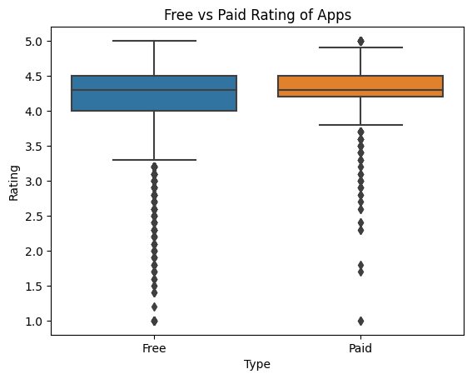
What percentage of apps are paid and free?
Which Type of App are having higher rating between Paid and Free apps?
Above boxplot shows that we do not have any major difference in Rating between the free and paid apps.
Free apps - 7747
Paid apps - 685

Slide 10
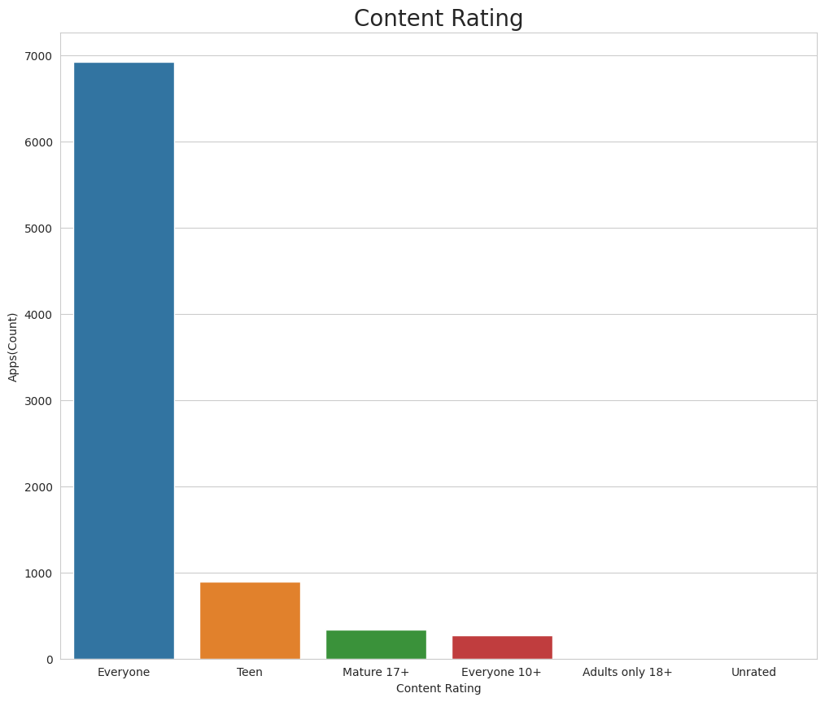
Which category of App from the ‘Content Rating’ column is found more on the play store?
From the above plot, we can see that the 'Everyone' category has the highest number of apps
Adults only 18+ apps , unrated apps are not present here.

Slide 11
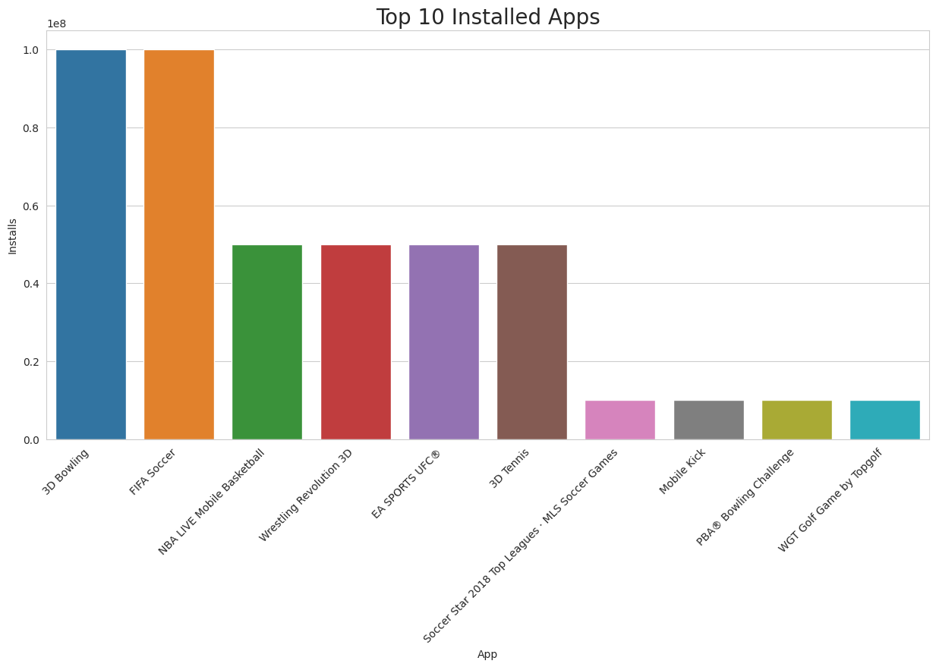
What are the Top 10 installed apps in any category(particularly here mentioned is sports)?
From the above graph, we can see that in the Sports category 8 Ball Pool, 3D Bowling, Dream League Soccer 2018 & FIFA Soccer has the highest installs.

Slide 12
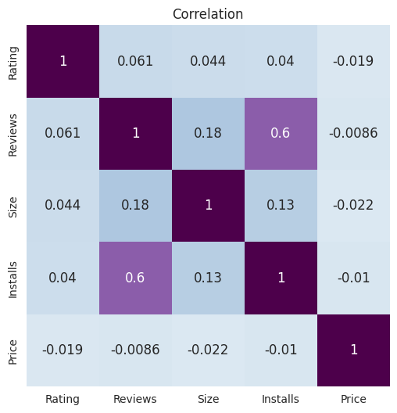
Bivariate Analysis
Correlation Heatmap
Installs and Reviews have the strongest correlation
Rating has negative relation with Price
Installs has positive relation with Size but it is very weak

Slide 13
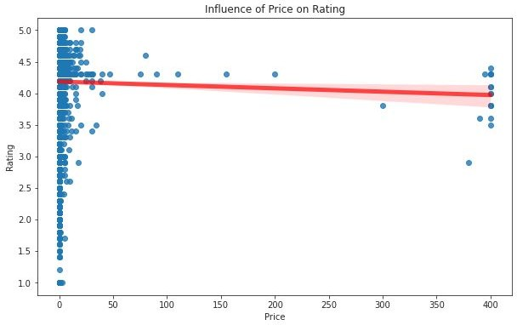
Does rating change with increasing price?
There is negative relation between price and rating.
Rating decreases with increasing price.

Slide 14
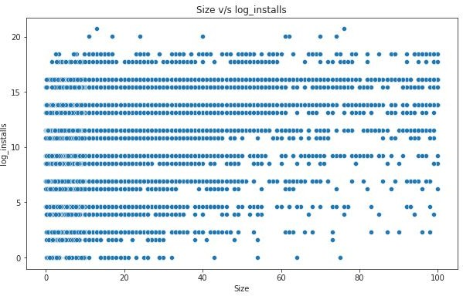
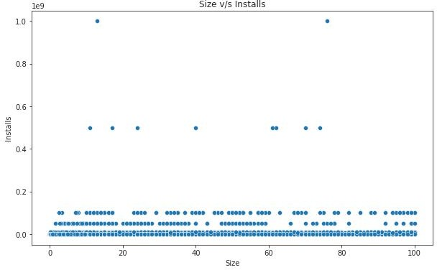
Does the size of an app influence the installs?
Before Log Transformation

Slide 15
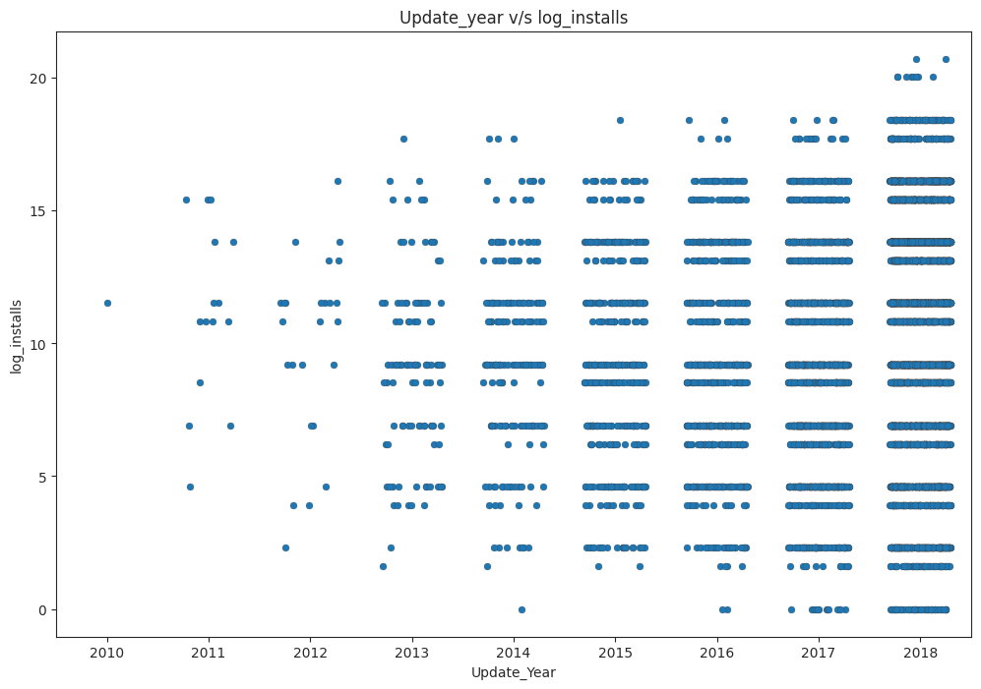
Are app updates important?
Most of the apps get frequent updates.
Updating apps can improve the user experience.
leads to more convenience and increased engagement in the use of the app.

Slide 16
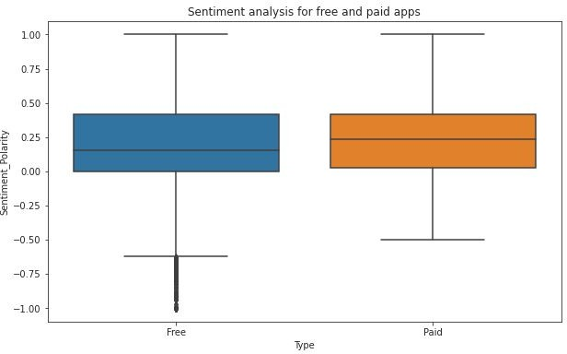
Sentiment analysis for free and paid apps
Free apps get more negative reviews.
Median polarity is higher for paid apps.

Slide 17
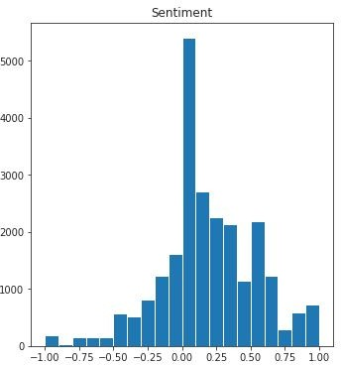
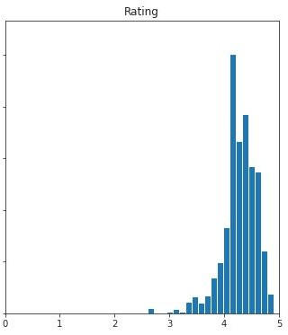
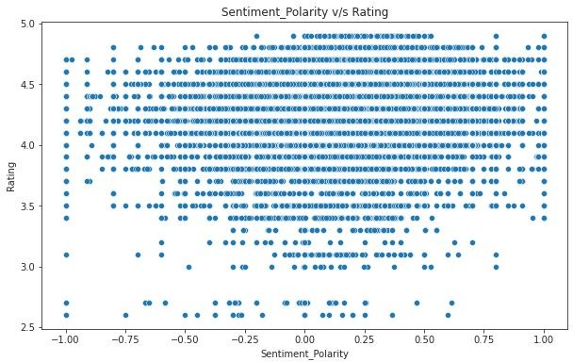
Are sentiment influences the final rating of the app?
Positive trend for both rating and sentiment

Slide 18
Conclusion
Family category has more apps on the play store but Game category is the most popular category.
Approx. 91% apps on play store are free apps and Medical and Personalisation apps generally do well as paid apps.
Users prefer apps that require less space. Bulky apps are downloaded less.
App ratings and reviews have a significant impact on a user's decision to download or not download an app.
Updating the app can improve user experience and happy users attract more new users.
Sentiments in reviews also matters in attracting new users as other user's positive reviews about the app strengthen the decision to download.

Slide 19
Challenges
Data cleaning was the most time consuming phase and whether to drop the null values or fill them was the real challenge.
Installs and reviews were highly skewed and getting undesirable results lead to lots of search reaching to a solution of log transformation.
Reviews dataset has so much data and it was little difficult to handle.

